Slide 1

Review 1 Embedded Machine Learning for Early Prediction of Heart Attack Symptoms Project Category: PRODUCT/ RESEARCH
Guide Name Student Name & Registration Number
Dr. R Jeya
VIVEK M G – RA2211003010002
RAGHURAM SRIKANTH – RA2211003010218

Slide 2
Abstract
Heart attacks are the leading cause of sudden deaths and crashes, often due to missed early signs.
This project integrates Embedded Machine Learning (ML) with both electric and fuel-powered cars to predict heart attack symptoms in real time.
The system continuously monitors physiological signals and processes them locally using a lightweight ML model.
It detects potential heart problems and sends instant warnings to the driver.
This reduces the risk of crashes caused by medical emergencies and helps save lives.
The approach makes cars smarter and more health-conscious, improving driver safety and healthcare integration.

Slide 3
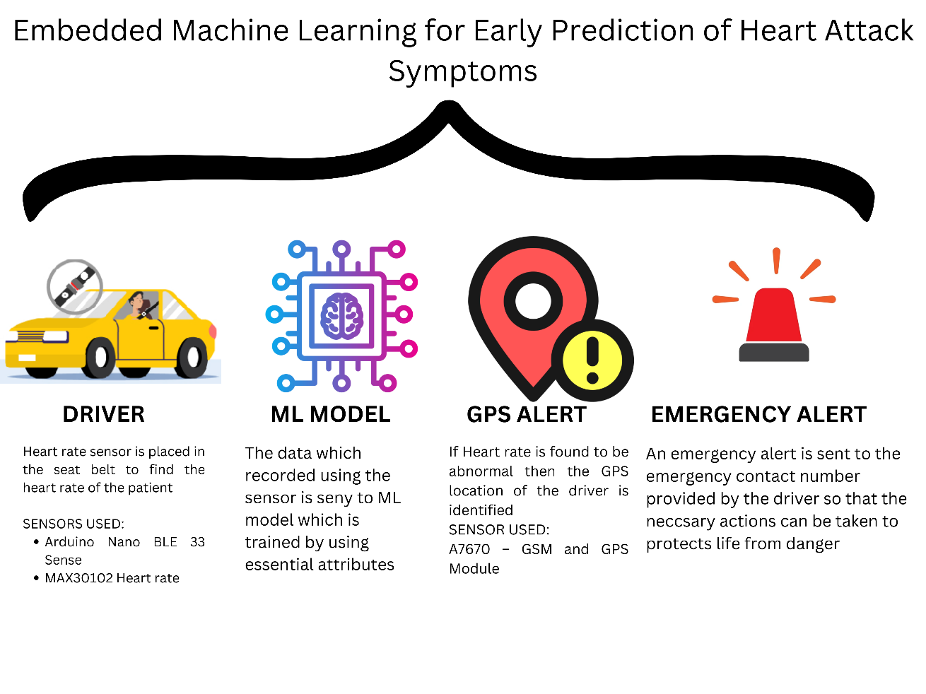
Introduction
Many people don’t realize they're having a heart attack until it's too late.
Heart attacks are a major cause of sudden deaths and car crashes.
Embedded Machine Learning (ML) is integrated into cars to predict heart attack symptoms in real-time while driving.
The system monitors bodily signals such as:
Heart rate
Blood pressure
Oxygen levels (SpO2)
A lightweight machine learning model processes the data locally for faster analysis and response.
If any irregularities are detected, the system immediately alerts the driver.
This innovative approach enhances vehicle safety by reducing health-related accidents on the road.

Slide 4
Project Objective
To develop a real-time, vehicle-integrated Embedded Machine Learning (ML) system for the early prediction of heart attack symptoms by continuously monitoring physiological signals such as heart rate, SpO2, and HRV. The system will process data locally, provide instant alerts to the driver, and enhance road safety by preventing health-related accidents, ensuring a safer and smarter driving experience in both electric and fuel-powered vehicles.

Slide 5
Product Vision Statement
To develop an intelligent, real-time, and vehicle-integrated early heart attack prediction system that enhances road safety by continuously monitoring driver health, providing timely alerts, and enabling emergency interventions, ensuring a safer and smarter driving experience in electric vehicles.

Slide 6
Literature Survey
S. No | Title | Methodology | Identification of gaps and limitations.
1 | Accident prevention and safety assistance using IoT and machine learning | Raspberry Pi Camera EAR (Eye Aspect Ratio) Algorithm MAR (Mouth Aspect Ratio) Algorithm Alcohol Sensors Gas Sensors Machine Learning Algorithms | The system lacks a mechanism to detect yawning, a key indicator of driver drowsiness. There is no alert system to notify the car owner or warn the driver about unsafe behavior detected by alcohol sensors. The system's effectiveness depends on sensor accuracy, which may be affected by poor lighting or sensor errors
2 | Heart Disease Detection by Using Machine Learning Algorithms and a Real-Time Cardiovascular Health Monitoring System | Machine Learning Algorithms: SVM showed the best accuracy among Naïve Bayes, SVM, ANN, Random Forest, and Logistic Regression tested in WEKA for heart disease prediction. Data Source: Two open-access datasets (Cleveland and Statlog Heart Disease) were merged, yielding 566 records with 13 attributes for enhanced robustness. Real-Time Monitoring & Cloud Application: An Arduino-based system monitors heart rate, temperature, and humidity, transmitting data to a cloud server with a mobile app for patient-doctor communication. | •The system does not include a mechanism to detect yawning, another critical indicator of driver drowsiness. •There is no alert mechanism in place for notifying the car owner or providing warnings to the driver when unsafe or unauthorized driving behavior is detected through the alcohol sensors. •The system’s effectiveness is heavily reliant on the continuous and accurate functioning of sensors, which may be impacted by poor lighting conditions or sensor inaccuracies.

Slide 7
Literature Survey
S. No | Title | Methodology | Identification of gaps and limitations.
1 | Accident prevention and safety assistance using IoT and machine learning | Raspberry Pi Camera EAR` (Eye Aspect Ratio) Algorithm MAR (Mouth Aspect Ratio) Algorithm Alcohol Sensors Gas Sensors Machine Learning Algorithms | The system lacks a mechanism to detect yawning, a key indicator of driver drowsiness. There is no alert system to notify the car owner or warn the driver about unsafe behavior detected by alcohol sensors. The system's effectiveness depends on sensor accuracy, which may be affected by poor lighting or sensor errors
2 | Heart Disease Detection by Using Machine Learning Algorithms and a Real-Time Cardiovascular Health Monitoring System | Machine Learning Algorithms: SVM showed the best accuracy among Naïve Bayes, SVM, ANN, Random Forest, and Logistic Regression tested in WEKA for heart disease prediction. Data Source: Two open-access datasets (Cleveland and Statlog Heart Disease) were merged, yielding 566 records with 13 attributes for enhanced robustness. Real-Time Monitoring & Cloud Application: An Arduino-based system monitors heart rate, temperature, and humidity, transmitting data to a cloud server with a mobile app for patient-doctor communication. | •The system does not include a mechanism to detect yawning, another critical indicator of driver drowsiness. •There is no alert mechanism in place for notifying the car owner or providing warnings to the driver when unsafe or unauthorized driving behavior is detected through the alcohol sensors. •The system’s effectiveness is heavily reliant on the continuous and accurate functioning of sensors, which may be impacted by poor lighting conditions or sensor inaccuracies.

Slide 8
Literature Survey
S. No | Title | Methodology | Identification of gaps and limitations.
3 | Prediction of Heart Disease Using a Combination of Machine Learning and Deep Learning | Dataset: Public health dataset derived from Cleveland, Hungary, Switzerland, and Long Beach V databases, consisting of 76 attributes, with 14 key features selected for this study. Preprocessing: Outliers handled using the Isolation Forest method. Dataset balanced and feature selection applied using the Lasso algorithm. Machine Learning Approaches: Tested Logistic Regression, K-Nearest Neighbors, Decision Trees, Random Forest, SVM, and XGBoost. Feature selection and dimensionality reduction techniques were applied to enhance model performance. Deep Learning Approach: Implemented a sequential deep learning model with three dense layers, using ReLU activation for hidden layers and Sigmoid activation for the output layer. Included Dropout layers to prevent overfitting. | Hardware Constraints: The system lacks clinically approved PPG-based blood pressure sensors, limiting medical accuracy. Data Generalization: The model was trained on merged datasets but remains unvalidated for other populations. Mobile Application: The proposed mobile app was not implemented, and no real-world testing was conducted. Internet Dependency: The system relies on cloud connectivity, which may cause issues in regions with poor network access.
4 | Heart Disease Prediction Based on the Embedded Feature Selection Method and Deep Neural Network | Feature Selection: Implemented an embedded feature selection method using LinearSVC with L1 norm (Lasso) as a penalty term to select the most relevant features, reducing dimensionality and improving model efficiency. Deep Neural Network (DNN): Designed a multi-layer DNN model for heart disease prediction, where the selected features were fed into the network to enhance learning and classification performance. Data Preprocessing: Applied outlier removal using the IQR method to eliminate anomalies and performed data standardization to ensure consistent feature scaling, leading to improved model accuracy. Weight Initialization: Evaluated different weight initialization techniques, concluding that the He initializer provided the best stability and accuracy by maintaining proper weight distribution and avoiding vanishing/exploding gradient issues. | Retraction:The paper has been retracted due to issues with the publication and peer-review process, which may compromise the reliability of the findings. Generalizability:While the dataset from Kaggle was used, the model's applicability to broader datasets or diverse populations remains uncertain. Model Optimization:Further improvements in model optimization, including adjustments to the DNN's depth and parameters, are suggested but were not fully explored in this paper. Feature Removal:Although some features were discarded based on feature selection, the impact of removing those features was not exhaustively tested

Slide 9
Literature Survey
S. No | Title | Methodology | Identification of gaps and limitations.
5 | IoT Based Accident Prevention System using Machine Learning | Machine Learning Models: Random Forest, LightGBM, XGBoost Dataset: Countrywide Traffic Accident Dataset (2.8 million vehicle accidents in the US from 2016 to 2021) IoT Data: Location, time, weather, wind speed, visibility, temperature Evaluation Metrics: Accuracy, precision, recall, F1-score, ROC-AUC IoT devices for collecting location, time, weather, wind speed, visibility, and temperature data | Potential bias due to the dataset being focused on a specific region (the United States) The model’s performance might vary with different datasets or real-time conditions.
6 | A New Smart Healthcare Framework for Real-Time Heart Disease Detection Based on Deep and Machine Learning | Development of a smart healthcare framework (SHDML) for heart disease detection. Use of photoplethysmogram (PPG) sensors connected to an ATmega32 microcontroller for real-time heart rate monitoring. Integration of machine learning and deep learning models for real-time heart disease prediction using data from Framingham Heart Study and PPG sensors. Data preprocessing (normalization, missing value handling) and training machine learning models (SVM, Logistic Regression, ANN, etc.) alongside deep learning techniques like CNNs. Data stored and processed via Firebase cloud, with results displayed on Android and desktop apps. | Size of the ATmega32-based device needs reduction for practical use. Limited sensors (no temperature or blood pressure monitoring). Room for improvement in the user interface and model prediction accuracy. Lack of diverse and larger datasets for validation. .

Slide 10
Literature Survey
S. No | Title | Methodology | Identification of gaps and limitations.
7 | Hybrid driver monitoring system based on Internet of Things and machine learning | Integration of smart wearable devices, smartphones, in-vehicle data collection devices, and intelligent transportation information collection device Machine Learning Algorithms | The accuracy of driver state monitoring may be affected by various external factors and the limitations of ML algorithms
8 | Application of IoT and Machine Learning for Real-time Driver Monitoring and Assisting Device | Implementation of IoT sensors (alcohol sensor and air pressure sensor) for sobriety checks and machine learning algorithms to detect micro-sleep and frequent yawns for drowsiness detection. The use of Raspberry Pi 3B+ microprocessor to process data from IoT sensors and cameras. Real-time analysis of camera feed for detecting signs of fatigue | The calibration of sensors and the requirement for a valid breath sample may pose challenges in real-world conditions. Limited computational resources of the Raspberry Pi microprocessor might restrict the scalability of the system.

Slide 11
Literature Survey
S. No | Title | Methodology | Identification of gaps and limitations.
9 | An IOT-Based Smart System for Accident Prevention And Detection | Utilized Arduino microcontroller with integrated sensors like MQ-3, infrared, accelerometer, and webcam. Real-time data monitoring with a threshold-based alert system. V2V Communication: Maintains safe distances using ultrasonic sensors. RFID Technology: Ensures valid license verification and registers up to ten authorized users. Alcohol Sensors: Prevents the bike from starting if alcohol is detected. Accelerometers & Vibration Sensors: Detects accidents and sends alerts via GPS and GSM. Eye Blink Monitoring (EBM): Detects drowsiness using IR sensors and triggers an alarm. Automatic Braking System: Detects red traffic signals and decelerates the bike. MEC Architecture: Captures accident scenarios and sends data to a server. | Reliance on Technology: System performance depends on sensor and module functionality, which may be affected by environmental or technical issues. RFID Limitations: Restricting registration to ten users may not be sufficient in some cases. Cost & Implementation: High integration costs and system complexity could limit widespread adoption. Data Privacy: Continuous monitoring and data transmission may raise privacy and security concerns.
10 | Heart Disease Identification Method Using Machine Learning Classification in E-Healthcare | Utilized ML classifiers like SVM, Logistic Regression, ANN, KNN, Naïve Bayes, and Decision Tree for heart disease diagnosis .Applied feature selection techniques, including Relief, MRMR, LASSO, and the novel FCMIM algorithm. Used the Cleveland Heart Disease dataset (297 samples, 13 attributes) with LOSO CV for model evaluation. | Limited Dataset: The small sample size (297) constrained training complex models like deep neural networks. Model Scope: Focused on selected ML classifiers without exploring ensemble or hybrid approaches. Generalization & Optimization: Performance may vary on different datasets, and further optimization is needed for real-time applications in resource-limited environments.

Slide 12
Research Gap
Lack of Embedded ML in Vehicles for Health Monitoring:
Most existing studies focus on standalone health monitoring systems rather than integrating machine learning directly into vehicles for real-time heart attack prediction.
Limited Real-time Response and Processing:
Previous research primarily relies on cloud-based or hospital-centric monitoring systems, which may cause delays. The need for edge-based, real-time processing remains unaddressed.
Absence of Integration with Electric and Fuel-powered Vehicles:
While IoT-based driver monitoring and accident prevention systems exist, there is a gap in research regarding how embedded ML can be specifically tailored for both electric and conventional vehicles.
Narrow Scope in Predicting Multiple Health Parameters:
Existing works often use only a single or limited number of physiological parameters (such as heart rate). A more comprehensive multi-parameter approach incorporating SpO2, HRV, and other vitals is needed.
Limited Proactive Accident Prevention Measures:
Most studies focus on post-accident analysis or general health monitoring rather than early prediction and prevention of heart attack-induced accidents.
Lack of Emergency Communication Features:
Current research does not extensively cover how an embedded ML system can integrate with emergency response systems to provide instant alerts to emergency services.

Slide 13
Product Backlogs
Product Backlog sample for Embedded Machine Learning for Early Prediction of Heart Attack Symptoms
ID | Title | Epic | User Story | Priority (MoSCoW) | Status | Acceptance Criteria | Functional Requirements | Non-Functional Requirements | Original Estimate | Actual Effort (In days)
1 | Heart Rate Monitoring System Integration | Health Monitoring | As a driver, I want the system to continuously monitor my heart rate so that any anomalies can be detected early. | Must Have | To Do | System accurately monitors heart rate within ±2 bpm accuracy. | Integrate heart rate sensors into the vehicle seating system. | Real-time data processing with less than 1-second latency. | 5 days
2 | Data Processing Unit for ML Model | Health Monitoring | As a developer, I want the system to process health data using embedded ML models so that predictions are accurate and fast. | Must Have | To Do | ML model processes data with at least 95% accuracy. | Implement edge computing unit capable of running ML algorithms. | Ensure model inference time is under 100ms. | 7 days
3 | Alert System Development | Health Monitoring | As a driver, I want to receive alerts if the system detects potential heart attack symptoms so that I can take immediate action. | Must Have | To Do | Alerts are triggered within 5 seconds of detection with clear instructions. | Develop alert mechanism including visual and auditory signals. | Alerts must be noticeable even in noisy environments. | 8 days
4 | User Interface for Health Data | Health Monitoring | As a user, I want to view my health data on the vehicle's infotainment system so that I am aware of my current health status. | Must Have | To Do | Display real-time heart rate and other vital signs on the dashboard. | Design UI components for displaying health metrics. | Interface should update every second without lag. | 6 days
5 | Emergency Contact Notification | Health Monitoring | As a driver, I want the system to notify emergency contacts if a critical condition is detected so that help arrives promptly. | Must Have | To Do | Emergency contacts are notified within 30 seconds of critical detection. | Implement automatic notification feature via SMS or call. | Ensure reliable communication even in low network areas. | 5 days
6 | Data Privacy Compliance | Health Monitoring | As a user, I want to use the app without an internet connection so that I can access its features and information even when I am offline | Must Have | To Do | All health data is encrypted and complies with GDPR standards. | Implement encryption protocols for data storage and transmission. | System must pass security audits and penetration tests. | 7 days
7 | Integration with EV Systems | Health Monitoring | As a user, I want my health data to be securely stored and processed so that my privacy is maintained. | Must Have | To Do | All health data is encrypted and complies with GDPR standards. | Ensure compatibility with existing vehicle ECUs and software. | System integration verified through comprehensive testing. | 5 days
8 | Continuous Model Improvement | Health Monitoring | As an engineer, I want the health monitoring system to seamlessly integrate with existing EV systems so that it does not interfere with vehicle performance. | Could Have | To Do | Health monitoring system operates independently without affecting vehicle performance. | Set up pipeline for continuous model training and deployment. | Updates should occur with minimal downtime (<1 minute) | 5 days
9 | Driver Feedback Collection | Health Monitoring | As a researcher, I want to collect feedback from drivers about the system’s performance so that future improvements can be made. | Should Have | To Do | Feedback collected includes both qualitative and quantittive data. | Ensure feedback is easy to provide and understand. | Ensure feedback is easy to provide and understand. | 4 days
10 | Power Consumption Optimization | Health Monitoring | As an engineer, I want the health monitoring system to consume minimal power so that it does not significantly affect the EV's battery life. | Should Have | To Do | Feedback collected includes both qualitative and quantitative data. | Optimize algorithms and hardware for low power consumption. | Regularly test power usage under different conditions. | 5 days

Slide 14
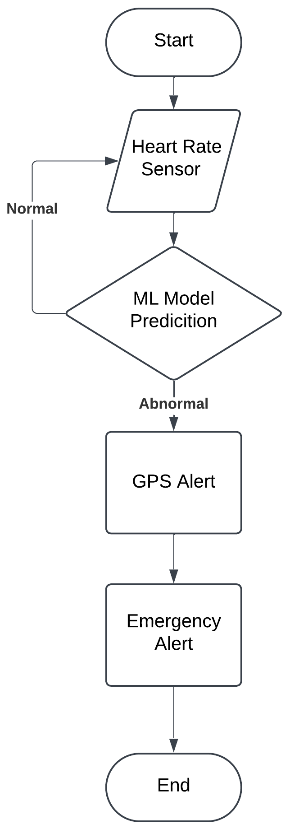
System Architecture based on current user stories

Slide 15
Product Roadmap/ Release Plan

Slide 16
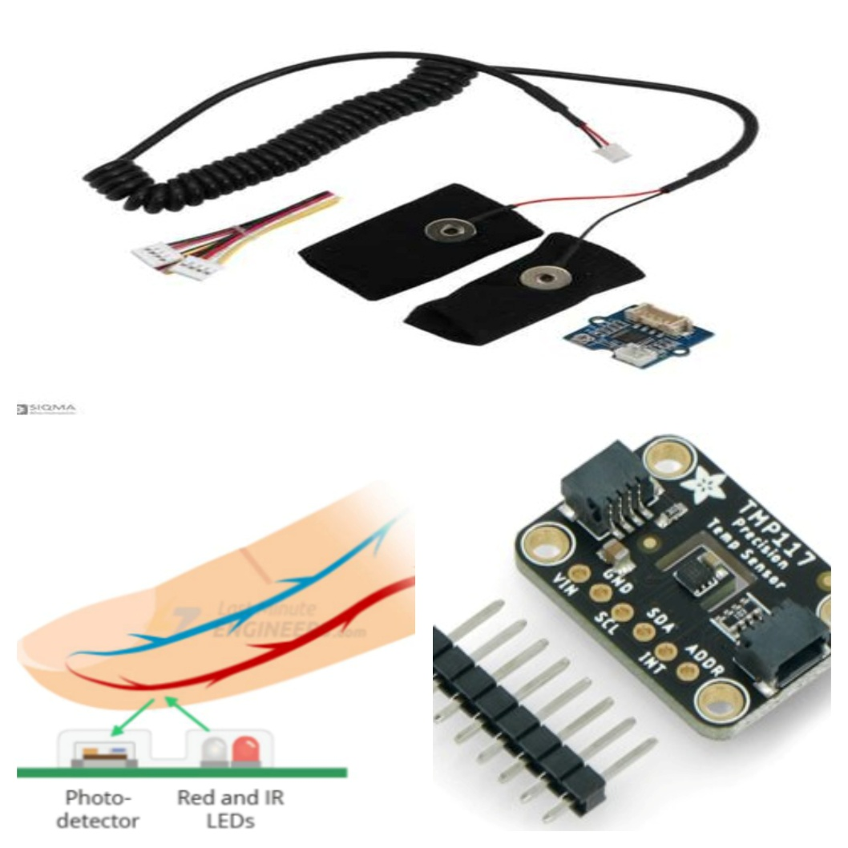
Hardware Requirements
1️⃣ MAX30102 - Heart Rate & SpO2 Sensor
Measures heart rate (BPM) and blood oxygen levels (SpO2) using optical sensing technology.
Low power consumption (suitable for continuous monitoring).
High accuracy in detecting irregular heartbeat and oxygen drops, which are key indicators of a heart attack.
2️⃣ GSR (Galvanic Skin Response) Sensor - Stress & Fatigue Detection
Measures electrical conductance of the skin, which changes due to stress or fatigue.
Detects abnormal stress levels, which can contribute to heart attacks.
Improves prediction accuracy when combined with heart rate data.
3️⃣ TMP117 - Digital Temperature Sensor
Measures body temperature, which can indicate circulatory issues or fever.
High-precision sensor (±0.1°C accuracy).
Helps detect body temperature fluctuations associated with heart distress.
🔹 System Workflow: Sensors collect real-time data, which is then processed locally on an Arduino Nano 33 BLE Sense Rev2 to predict heart attack symptoms using TinyML algorithms.

Slide 17
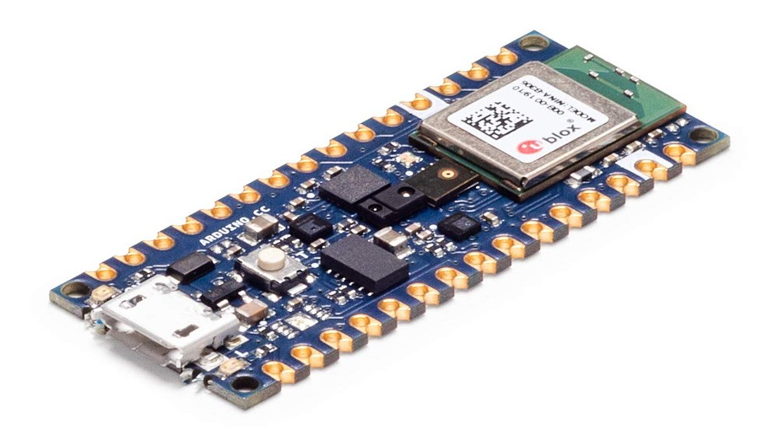
Why Did We Choose the Arduino Nano 33 BLE?
The Arduino Nano 33 BLE Sense Rev2 is an ideal microcontroller for this project due to:
✅ TinyML & TensorFlow Lite Support – Enables on-device ML inference. ✅ Bluetooth Low Energy (BLE) – Allows wireless health monitoring. ✅ IMU (Inertial Measurement Unit) – Helps detect sudden driver instability. ✅ Low Power Consumption – Suitable for continuous monitoring in vehicles. ✅ Compact Design – Easy to integrate into vehicle dashboards.
🔹 Additional Advantage: Unlike traditional cloud-based health monitoring, on-device ML processing ensures lower latency, higher privacy, and real-time decision-making, making this system highly efficient.

Slide 18

ML Implementation Using TensorFlow Lite
Step 1: Data Collection
Collect real-time readings from MAX30102 (Heart Rate/SpO2), GSR (Stress), and TMP117 (Temperature) sensors.
Use the synthetic_heart_attack_data_balanced.csv dataset for training.
Step 2: Data Preprocessing
Clean and normalize sensor data.
Remove noise and outliers to improve accuracy.
Step 3: Model Training
Train a lightweight ML model using heart attack symptom data.
Optimize the model for low-power embedded inference.
Step 4: Deploying to Arduino Nano 33 BLE Sense
Convert the trained model to TensorFlow Lite (TFLite).
Deploy it to the Arduino board for real-time health monitoring.
Step 5: Real-Time Prediction & Alerts
The deployed model analyzes sensor data in real-time.
If symptoms of a heart attack are detected, the system alerts the driver to take immediate action.

Slide 19
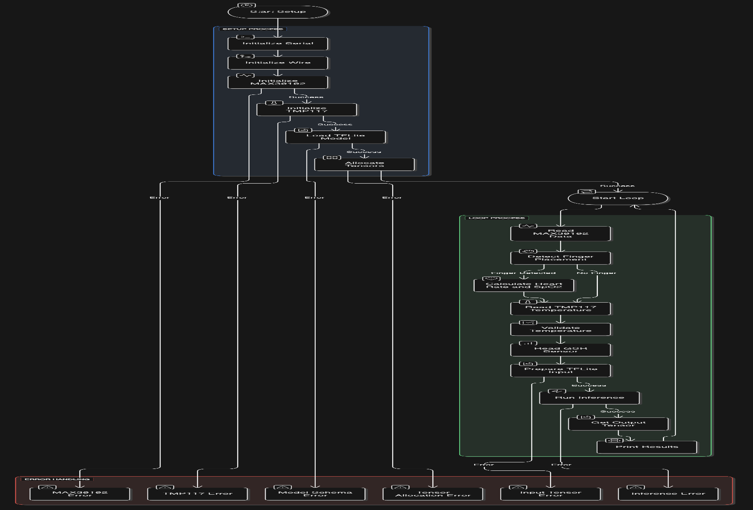
Final Architecture Diagram

Slide 20
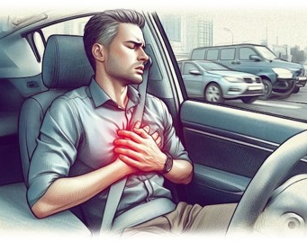
A Real-Time Product for Practical Implementation
This project is designed as a product-based solution that can be implemented in real-time applications. By integrating Embedded Machine Learning (ML) with vehicles, this system provides continuous health monitoring for drivers and ensures road safety.
✅ Can be integrated into Electric & Fuel-Powered Vehicles. ✅ Prevents accidents caused by sudden cardiac issues. ✅ Works in real-time, without cloud dependency. ✅ Sends alerts for early intervention, saving lives.

Slide 21

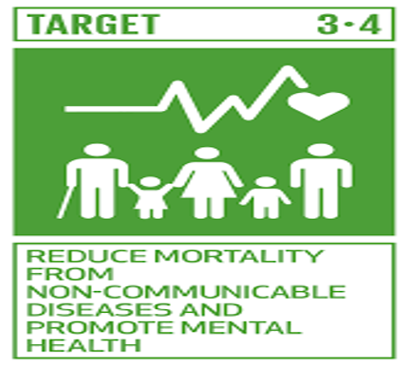
Project SDG
This project aligns with United Nations Sustainable Development Goal (SDG) 3: Good Health and Well-being, which focuses on ensuring healthy lives and promoting well-being for all at all ages.
How this project supports SDG 3?
🌍 Prevention of Life-Threatening Conditions
By detecting heart attack symptoms early, the system helps prevent fatal accidents and improves driver safety.
💙 Reducing Premature Mortality
Heart attacks cause sudden deaths, often due to unrecognized symptoms.
Early detection = Timely intervention = Lives saved.
📝 Aligns with SDG Target 3.4
This project directly supports SDG Target 3.4, which aims to reduce mortality from non-communicable diseases (NCDs) like cardiovascular diseases through prevention and treatment.

Slide 22
Conclusion
This project is not just an academic study—it is a real-time, product-based solution that supports global health objectives. By integrating ML with SDG 3 goals, this system saves lives, reduces accidents, and improves well-being worldwide.
With advancements in sensor technology and embedded ML, this system has the potential for widespread adoption in autonomous vehicles, fleet management, and commercial transportation.
As the demand for smart health monitoring systems increases, such innovations will play a crucial role in making healthcare proactive rather than reactive. This project lays the foundation for future research into multi-sensor fusion, AI-driven diagnostics, and IoT-enabled emergency response systems, contributing to a safer and healthier future for all.

Slide 23
References
Nashif, S., Raihan, M.R., Islam, M.R., Imam, M.H., 2018. Heart Disease Detection by Using Machine Learning Algorithms and a Real-Time Cardiovascular Health Monitoring System. World Journal of Engineering and Technology 6 (4), 854–873. https://doi.org/10.4236/wjet.2018.64057
Accident prevention and safety assistance using IoT and machine learning. 2021. Journal of Reliable Intelligent Environments 7, 185–198.
R. Bharti, A. Khamparia, M. Shabaz, G. Dhiman, S. Pande, and P. Singh, "Prediction of Heart Disease Using a Combination of Machine Learning and Deep Learning,“
D. Zhang, Y. Chen, Y. Chen, S. Ye, W. Cai, J. Jiang, Y. Xu, G. Zheng, and M. Chen, "Heart Disease Prediction Based on the Embedded Feature Selection Method and Deep Neural Network,“
H. Elwahsh, E. El-Shafeiy, S. Alanazi, and M. A. Tawfeek, "A New Smart Healthcare Framework for Real-Time Heart Disease Detection Based on Deep and Machine Learning,“
R. Alnashwan, A. Saad, H. Qudaih, and L. Albraheem, "IoT-Based Accident Prevention System Using Machine Learning Techniques,“
L. Zhu, Y. Xiao, and X. Li, "Hybrid Driver Monitoring System Based on Internet of Things and Machine Learning,“
P. Sharma and N. Sood, "Application of IoT and Machine Learning for Real-time Driver Monitoring and Assisting Device,“
C. V. S. Babu, A. N. S., and M. V. P., "IoT-Based Smart Accident Detection and Alert System," in Handbook of Research on Deep Learning Techniques for Cloud-Based Industrial IoT,
J. P. Li, A. U. Haq, S. U. Din, J. Khan, A. Khan, and A. Saboor, "Heart Disease Identification Method Using Machine Learning Classification in E-Healthcare,

Slide 24
Thank You

